Slide 1
RQ–30 CONTACT FREE DISCHARGE MEASUREMENT SYSTEM

Slide 2

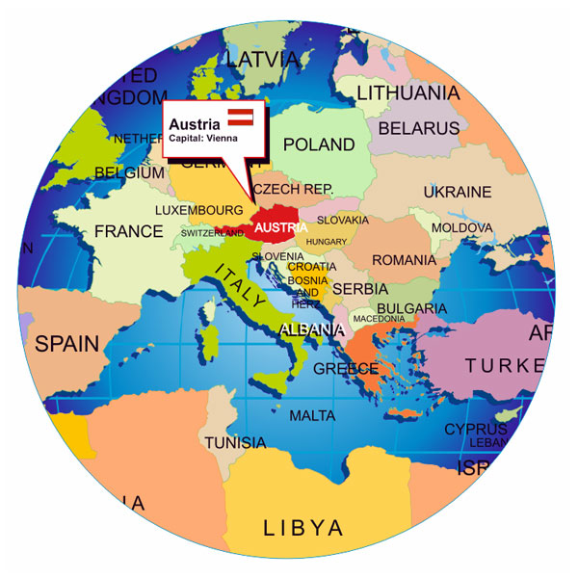


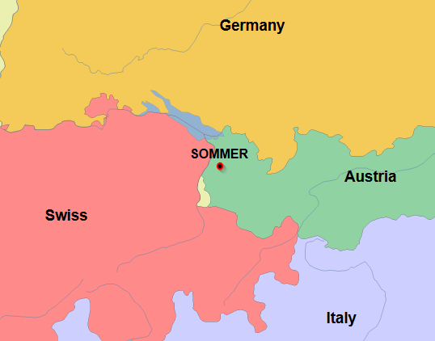
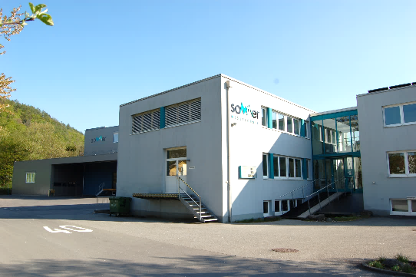
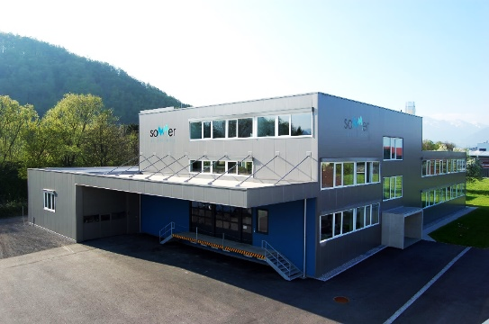
SOMMER - Information
was founded in 1987 in AUSTRIA and provides more than 30 years experience in development and production of high quality and innovative measurement equipment for hydrology and meteorology.
is a family owned company with excellent reputation. Customer focus, reliability, excellent service and high-end products are our commitment to you.
SOMMER Headquarter is located in west Austria SOMMER production facility
– opened May 2015

Slide 3


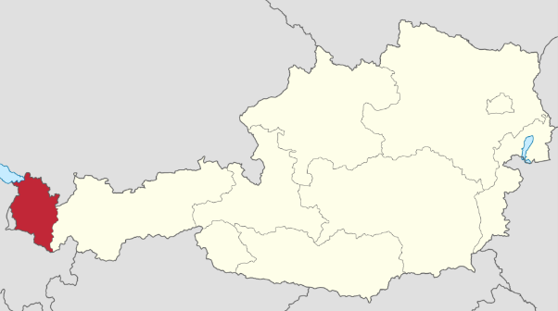
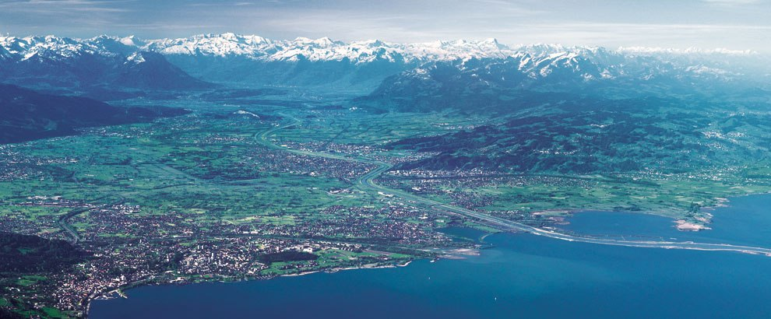
Vorarlberg - Austria
Beginning of the ALPS. Mostly mountainous area. In winter snow covered.
Flood danger if snow melt and rain at the same time

Slide 4
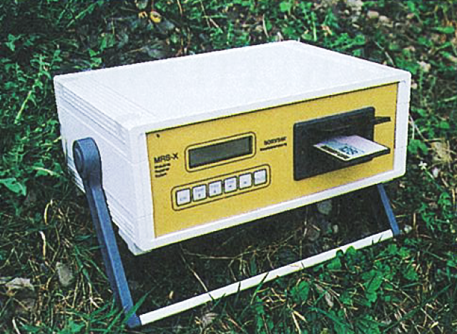
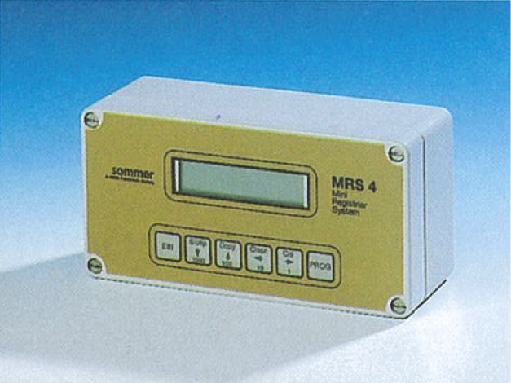
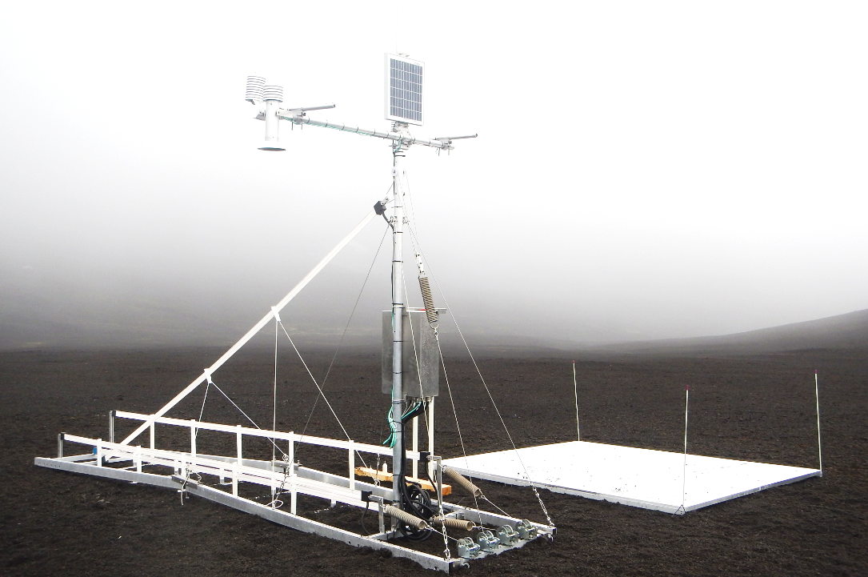
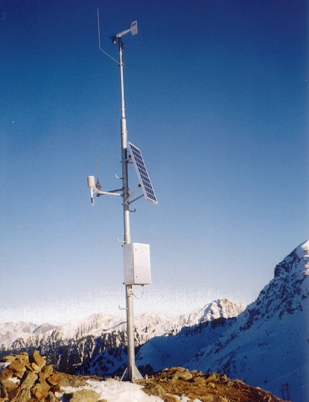
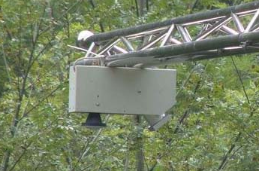
SOMMER - History
1987
started with the production of data logging systems and heavy duty weather station for high alpine conditions.
After getting well known for its robust and high quality ASW, kick-started the development of its snow measurement and analysis systems.
Soon after, developed it´s first generation of contact free discharge measurement Radars and started to promote its product world wide.
SOMMER MRS X and MRS 4 data logger
1990
SOMMER Snow Pack analyzer and SOMMER SSG installed in Antarctica (South pole). High quality instruments for the roughest conditions.
2005
SOMMER ASW in the European Alps
SOMMER RQ-24, first contact free discharge measurement Radar

Slide 5
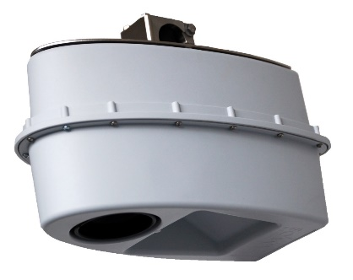
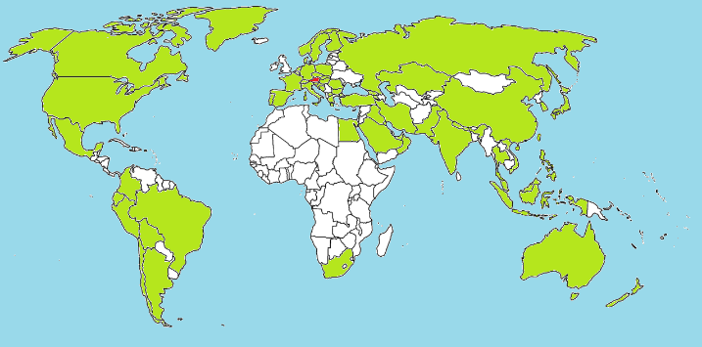
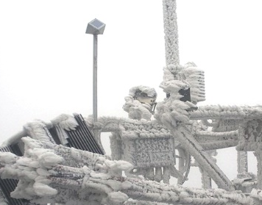
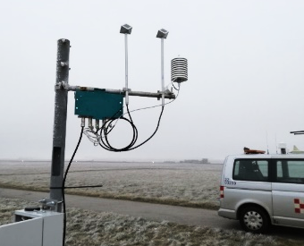


SOMMER - History
2015
used it´s specialized knowledge of measuring discharge in rivers and streams to develop a flow meter, for the non contact measurement of waste water, sewage systems and industrial waters, the SQ.
Worldwide distributor network is continuously growing. has distributer in 60 counties of the world on all continents.
After several year of perfecting, start selling it´s unique ice detection system the IDS-20.
opened its first overseas office in Kula Lumpur, Malaysia.
SOMMER SQ-flow meter
2016
SOMMER distributer Network
2017
SOMMER IDS-20 Installed on Wind turbine and at Vienna Airport
2018

Slide 6

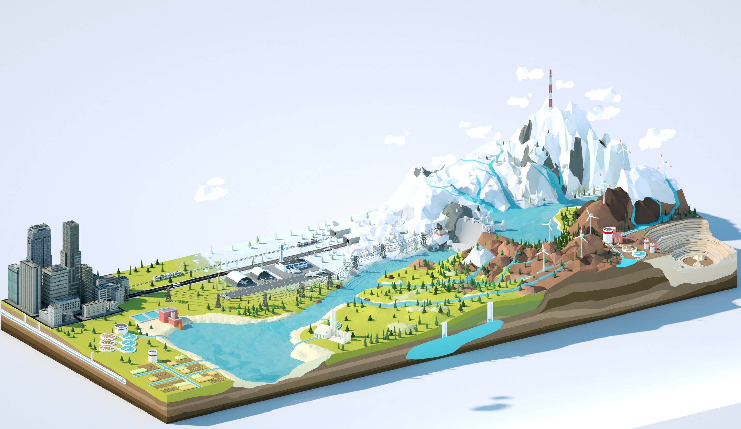




SOMMER – Area of activity
Meteorology – Measurement of different snow parameters and
snow melt analysis
Hydrology – Discharge and water level measurement of Rivers and streams
Flood warning systems and networks
Sewer and industrial waters – Discharge measurement of
open manmade channels and sewer systems
Mining industry – Measurement of water resources in snow
and measuring of water flows in the mining process
Ice detection – Detection of ice and ice growth in
different industries. (Wind power, Aviation, Power lines
communication, Railway,…)

Slide 7

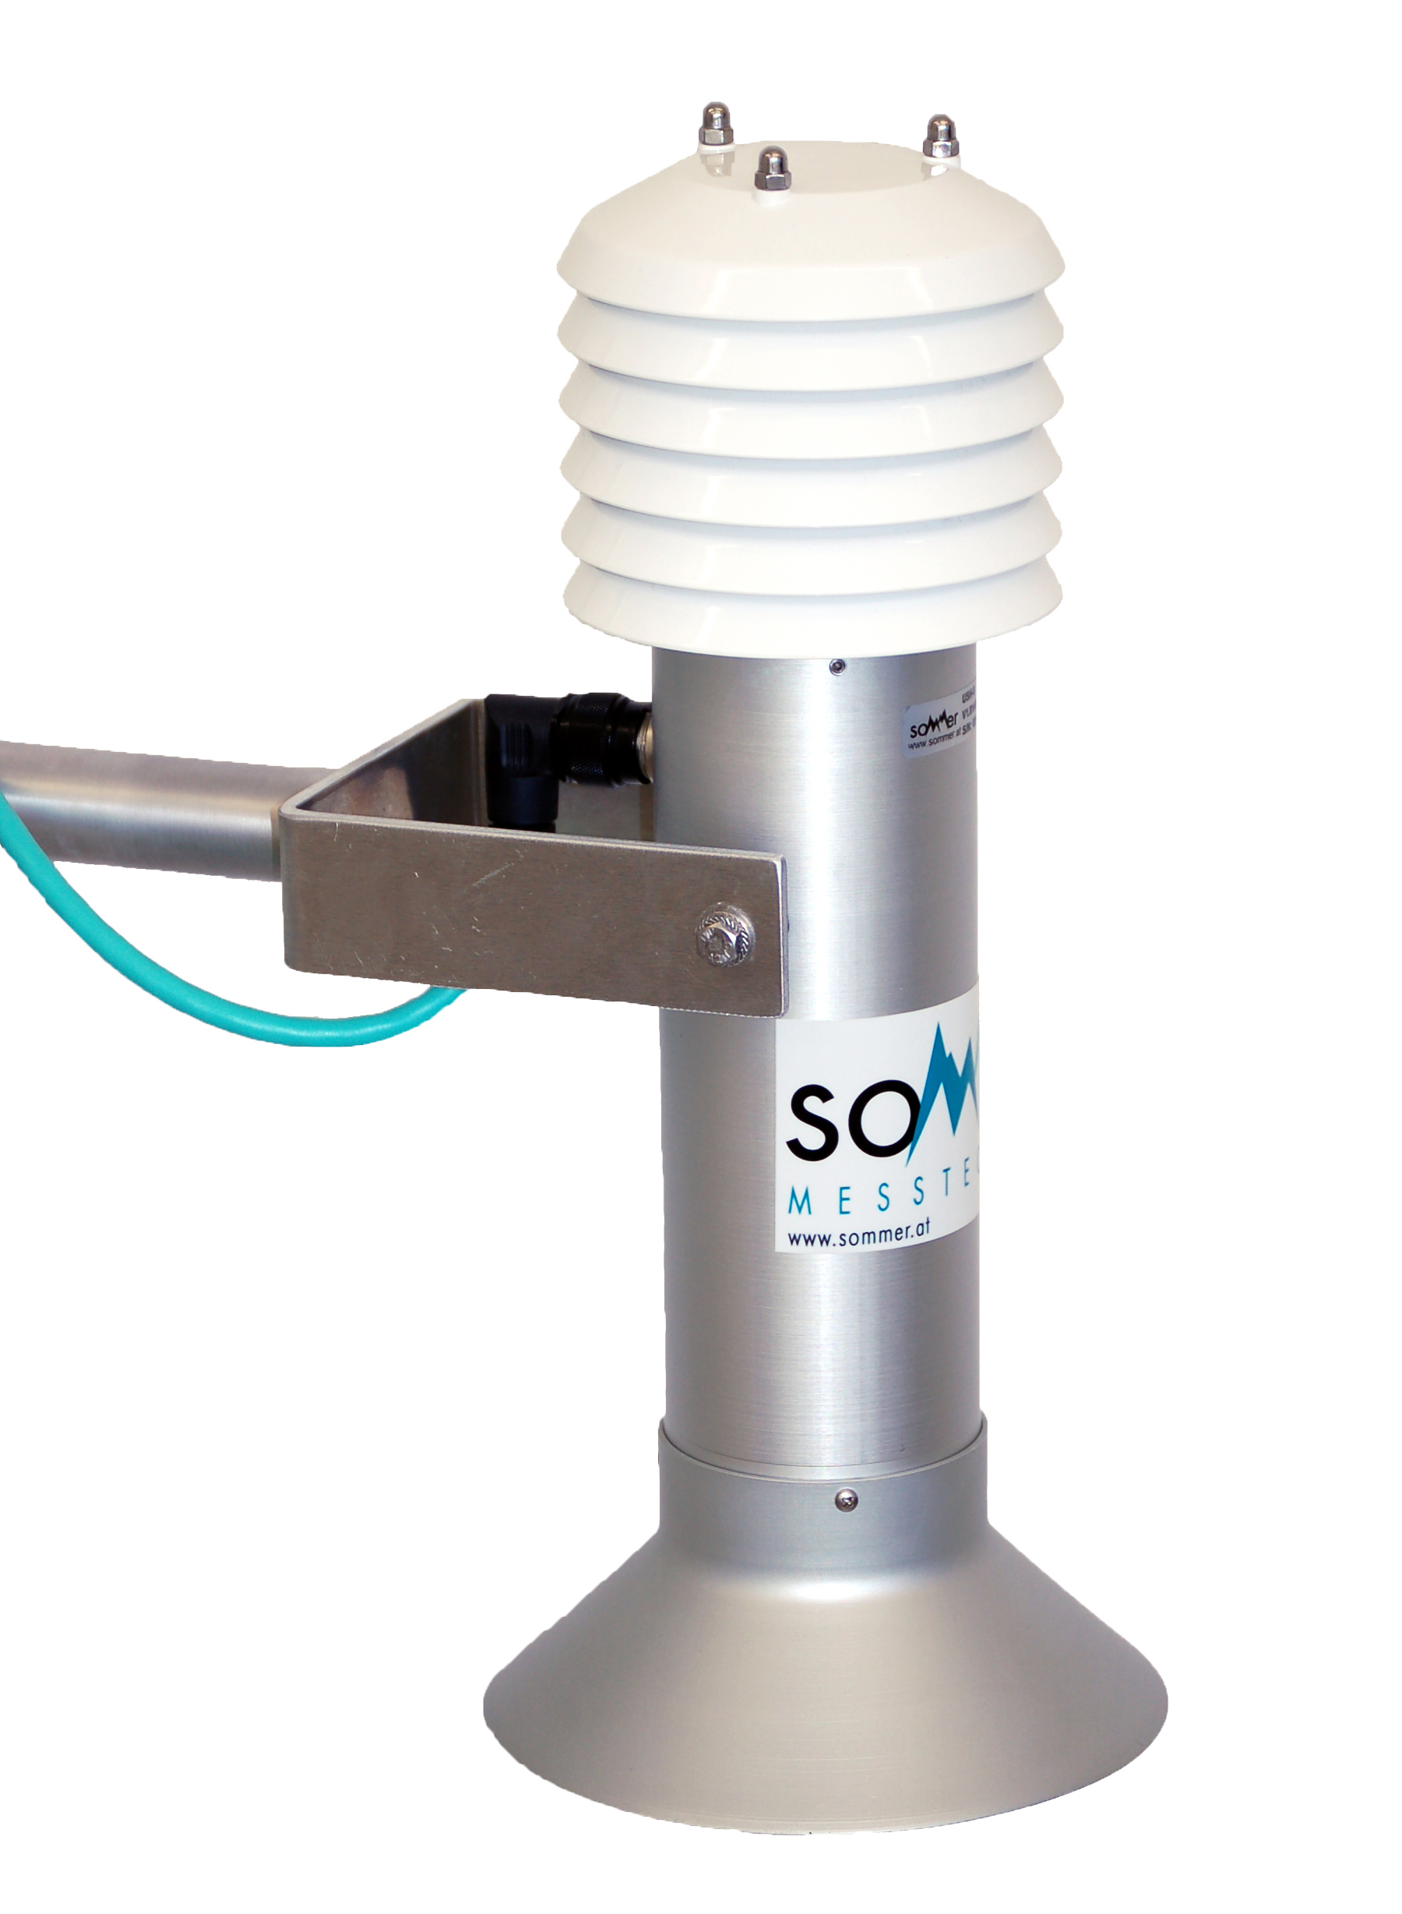
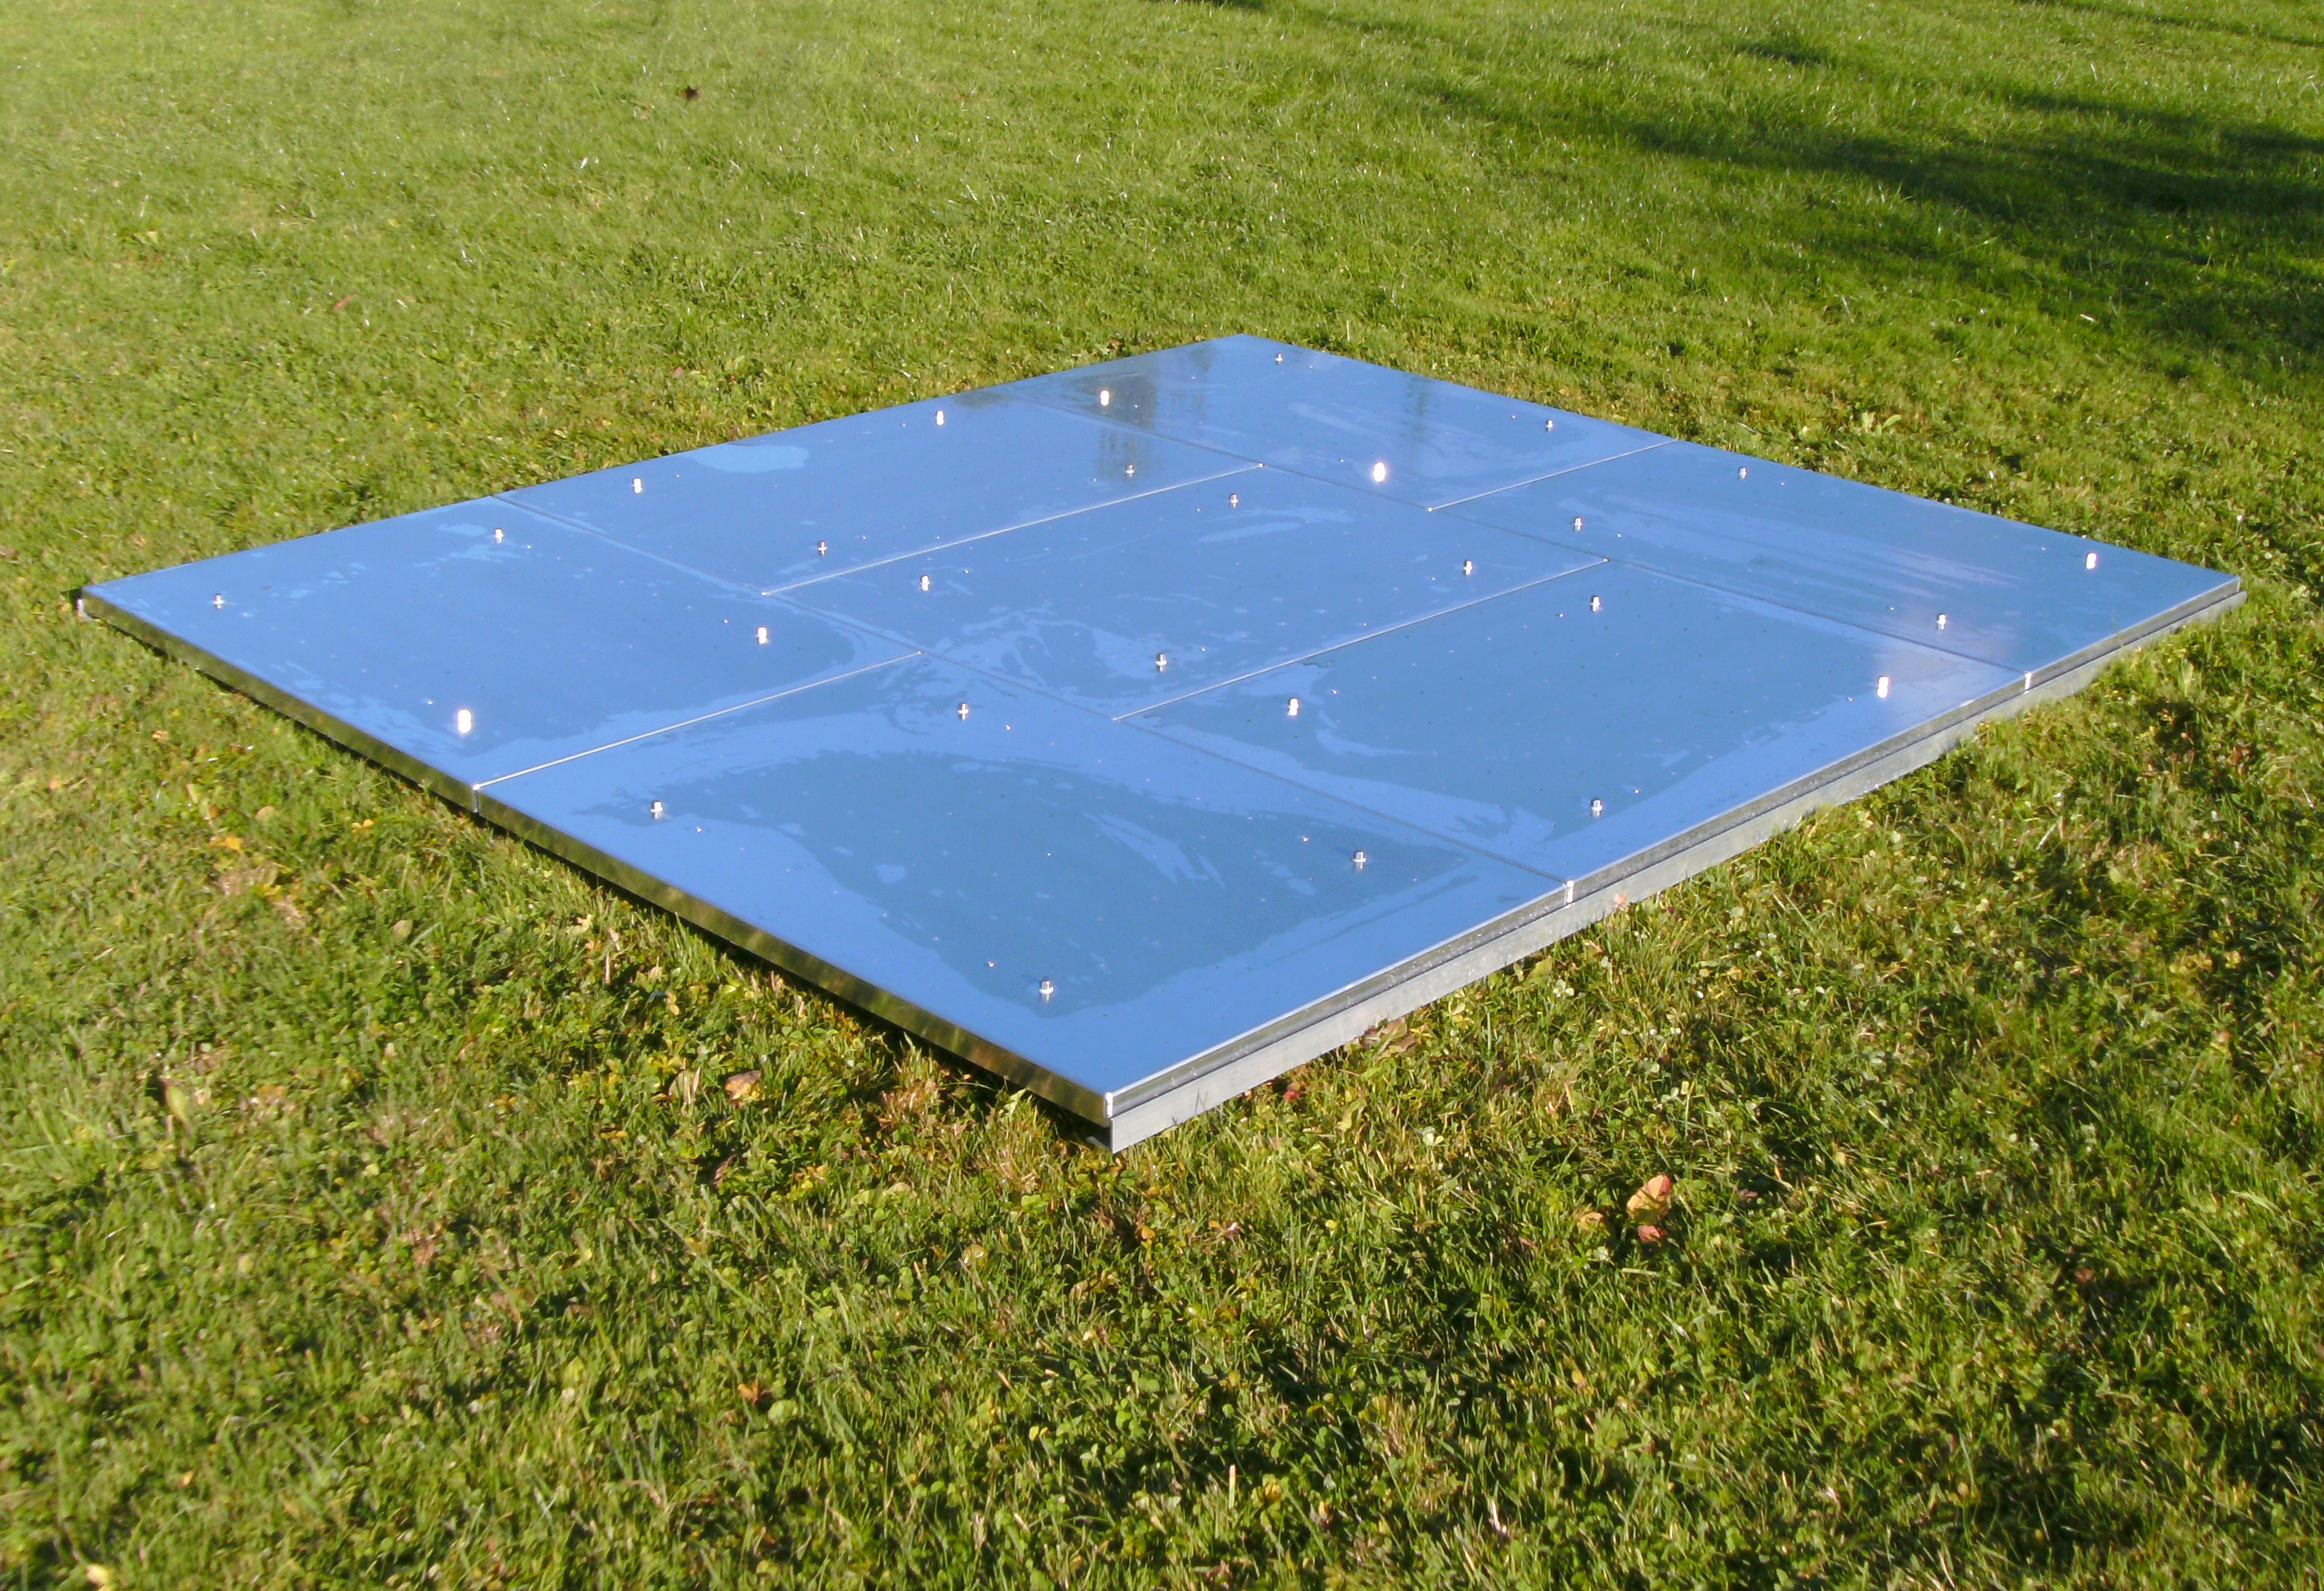

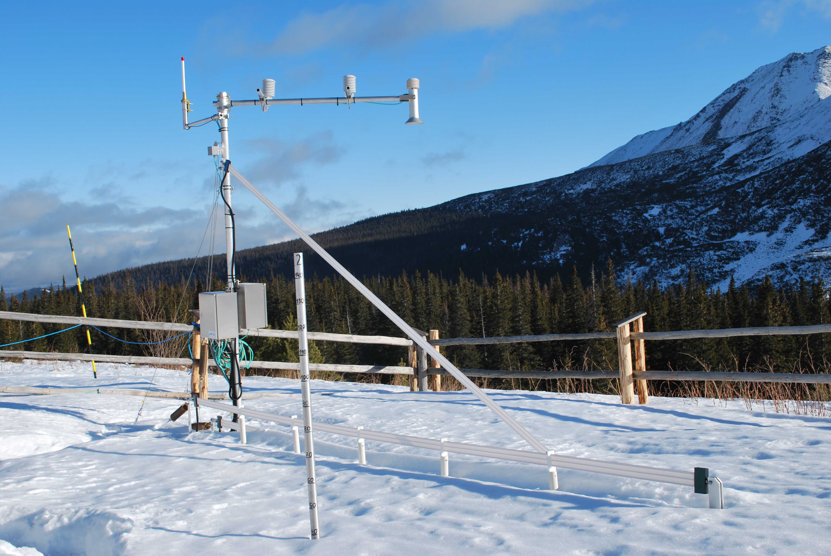
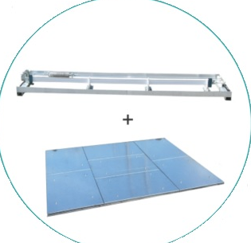
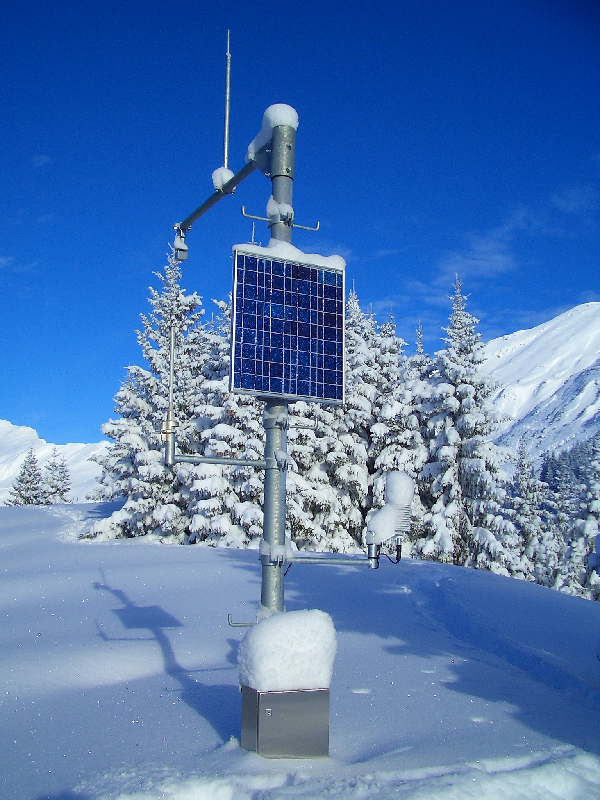
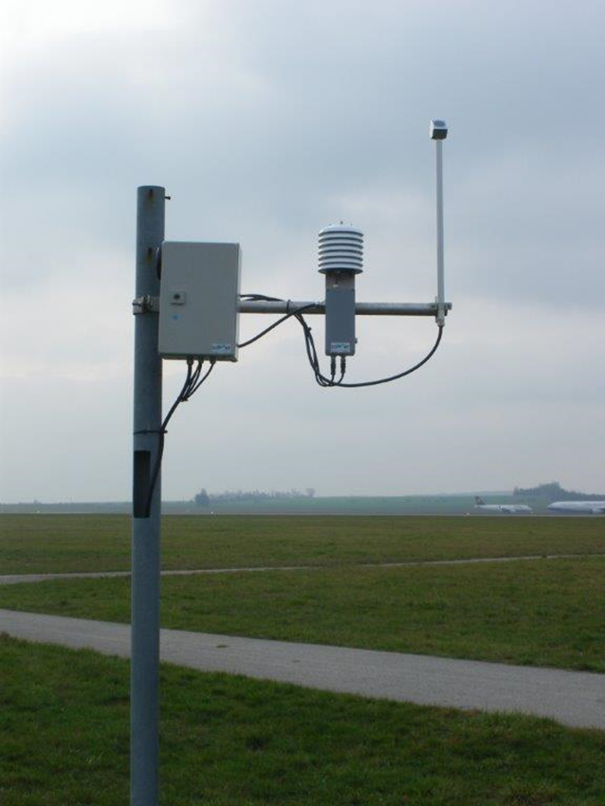
Meteorology
Snow Ice measurement sensors:
Snow Depth: USH-9
Maintenance free ceramic Membrane
Integrated Temp. compensation
High power pulse for best results during snowfall
Snow water equivalent (SWE): SSG – Snow scale
No antifreeze liquid required
Robust aluminum construction
Range from 200 to 3000 mm SWE
SWE + ice and water contend: SPA– Snow pack analyzer
Prediction of runoff
No ice bridging effect
SWE, snow-depth, snow density, liquid water and ice contend
Snow melting (Runoff): SMA-Snow melt analyzer
Prediction of runoff
Simple and easy installation
SWE, snow density, liquid water and ice contend close to the ground
Monitor environment: AWS – Automatic Weather station
Heavy duty weather station for high alpine areas
More than 30 years experience
Complete system out of one hand (Steel construction, sensors, software and know how)
Ice risk detection: IDS 20 – Ice detection sensor
Internal plausibility check (dew point/frost point , temp.)
Easy integration in existing systems
Different sensors for different applications (Airports, Antennas in mountain areas, power lines, wind turbines)

Slide 8
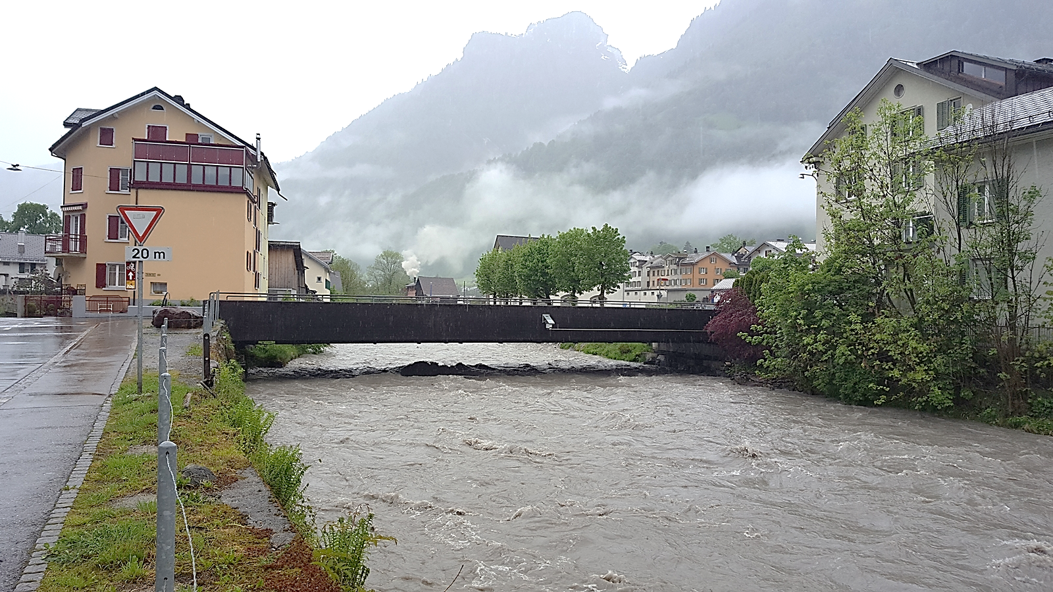
What instrument can you use here?

Slide 9
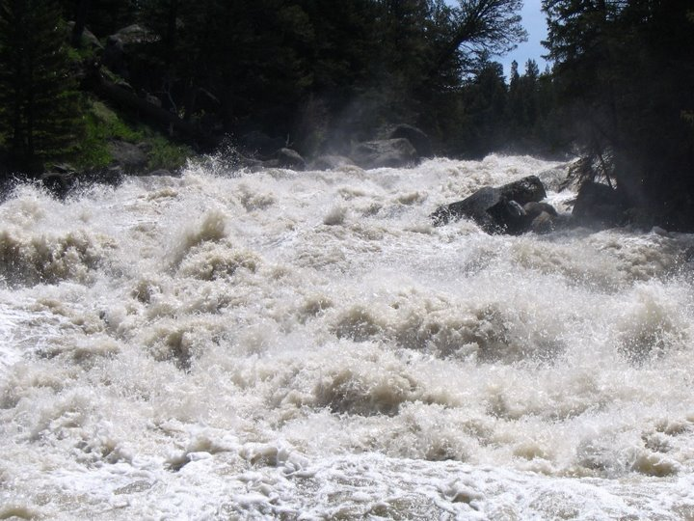
What instrument can you use here?

Slide 10
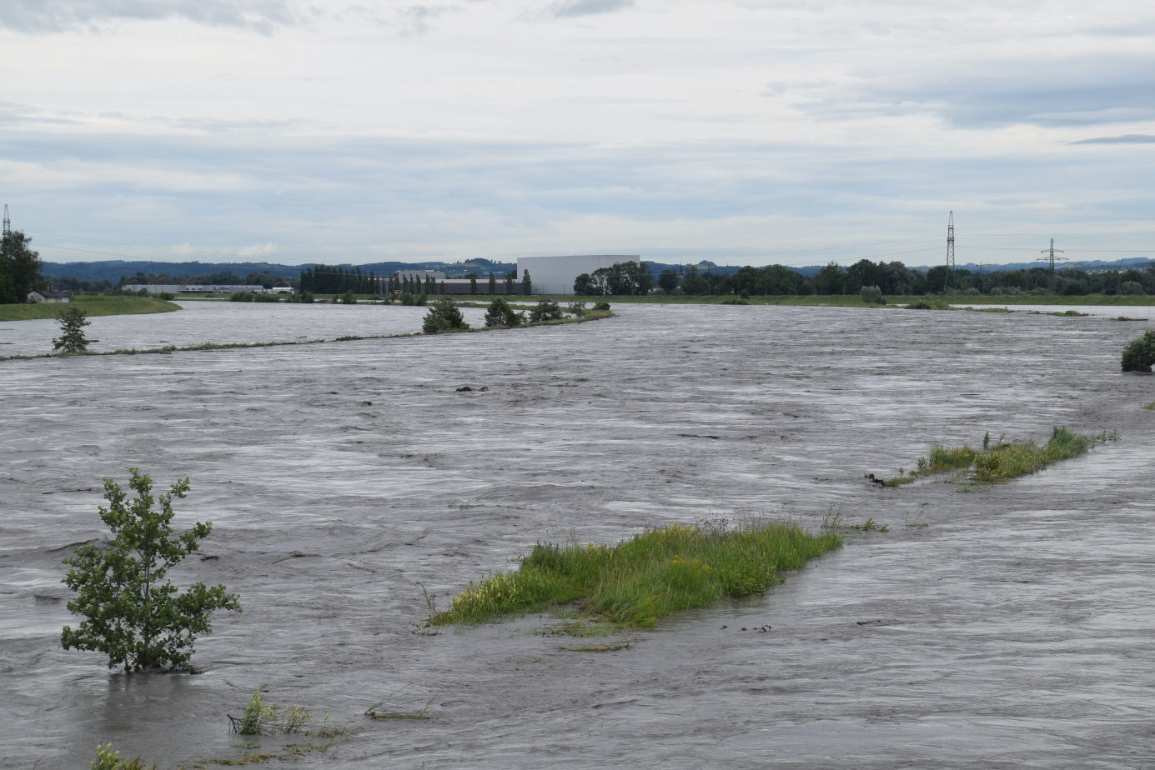
Rhine (Lustenau May 2016)

Slide 11

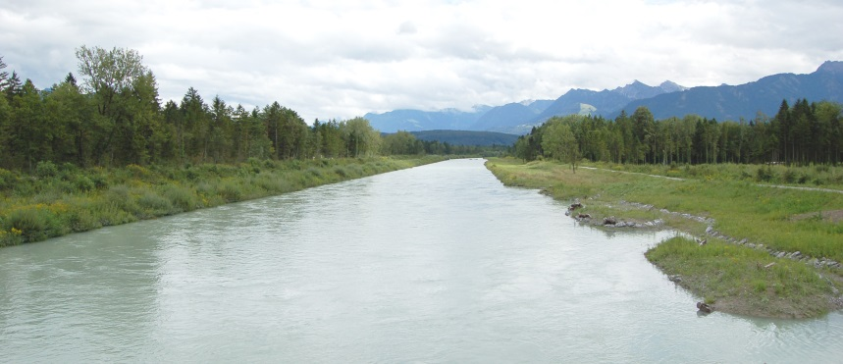

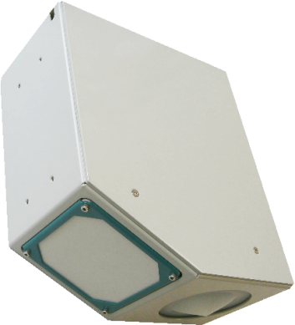
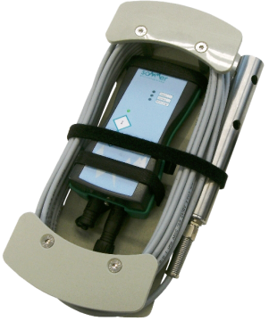
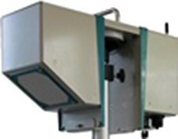
SOMMER – Discharge measurement
Non-Contact Radar Sensors
Tracer Dilution Method
Stationary RQ-30
Mobile RP-30
Mobile TQ-S / TQ-F

Slide 12

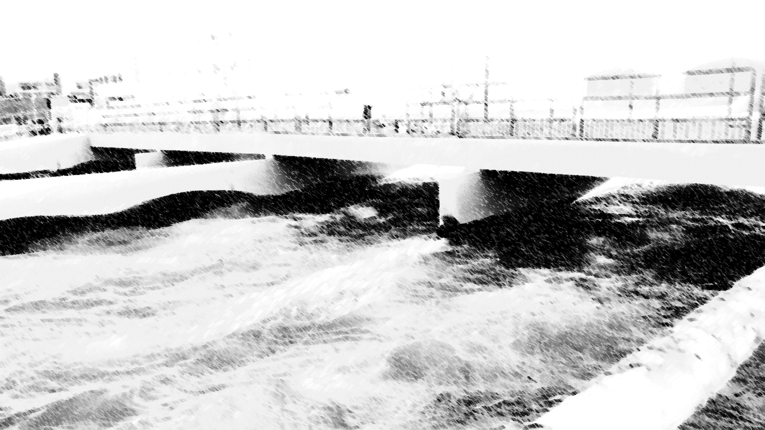
Hydrology
SOMMER is the global leading None contact radar based solution provider for measuring discharge
and has more then 15years expiriance
in applications
all arround the world with 1000 nd‘s of units
installed arround the globe.
SOMMER developed
a special complex
model revolutiionising and
making it to the most advanced
company in measurinig
contact free discharge and flow.

Slide 13
Non-Contact discharge Sensor - RQ-30
SOMMER - Hydrology

Slide 14
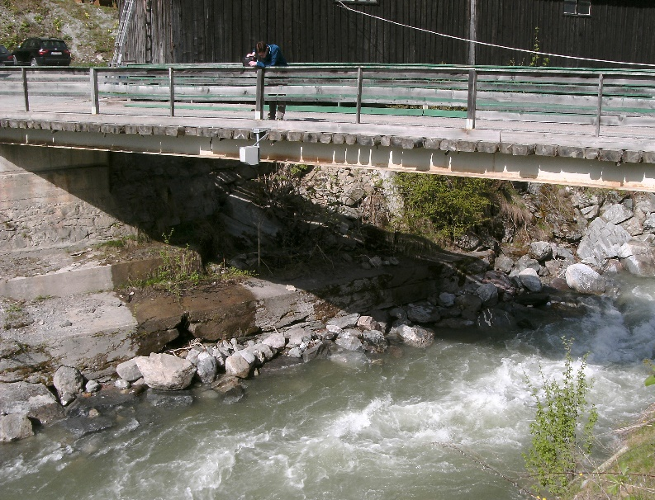
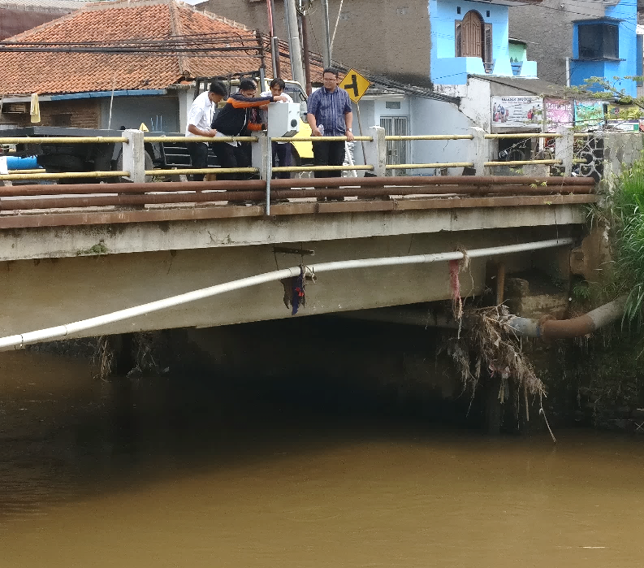
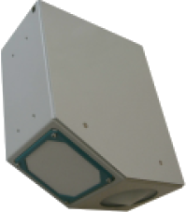
Contact free discharge measurement
Advantages of Contact free discharge measurement with RQ-30
Contact free measurement
Easy mounting and installation
! Maintenance free (because not in the water)
  High reliability at floods
  No damage of sensor by flotsam, trees, debris, bed load,…
  Discharge calculation in the sensor

Slide 15
RQ-30 Measurement principle
SOMMER - Hydrology

Slide 16
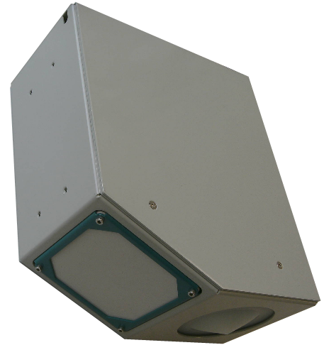

RQ-30 Water level sensor
Water level (stage)
Transit time measurement
Radar (26 GHz) Vertical to water surface
Time between transmitting and reflecting the pulse = directly proportional to the distance
Radar: independent of air temperature and medium (e.g. foam)
Notes:
The Water Level is measured through transit Time method. The Level sensor can be ultrasonic or radar technology. The Radar technology as a couple of advantages like, it is not influenced by the temperature and by foam on the water.
The Velocity in measured with Doppler frequency shift method and only comes as Radar technology. Because the Doppler frequency shift is a physical phenomena the velocity measuring is very accurate.

Slide 17
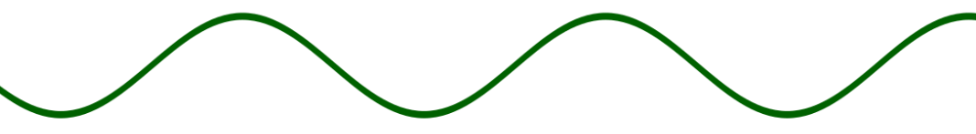
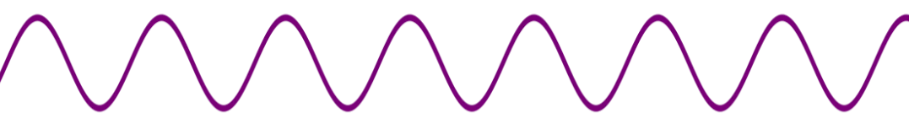
RQ-30 Velocity sensor
Flow velocity
Measurement of Doppler frequency shift (Doppler Effect)
Radar impulse (24 GHz) are shifted by the water surface waves
Frequency shift by movement on the water surface (min. swell 3mm )
Measurement of surface velocity, calculation of mean velocity with hydraulic model
Certified velocity measurement by METAS
Notes:
The Water Level is measured through transit Time method. The Level sensor can be ultrasonic or radar technology. The Radar technology as a couple of advantages like, it is not influenced by the temperature and by foam on the water.
The Velocity in measured with Doppler frequency shift method and only comes as Radar technology. Because the Doppler frequency shift is a physical phenomena the velocity measuring is very accurate.

Slide 18
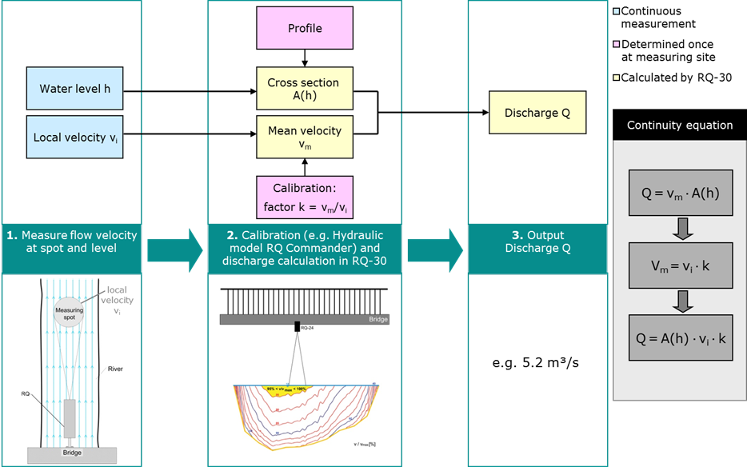
RQ-30 / SQ-Series Measurement Principle
Notes:
The RQ measure the water level. With the level and the river profile we calculate the wet area of the cross section of the river. The RQ also measure a local surface velocity. With our hydraulic model we calculate the relation between the local surface velocity and mean velocity at different stages.
The hydraulic model is based on modified equations from Manning and Strickler.
Mean velocity multiply by the wet area is the discharge.

Slide 19

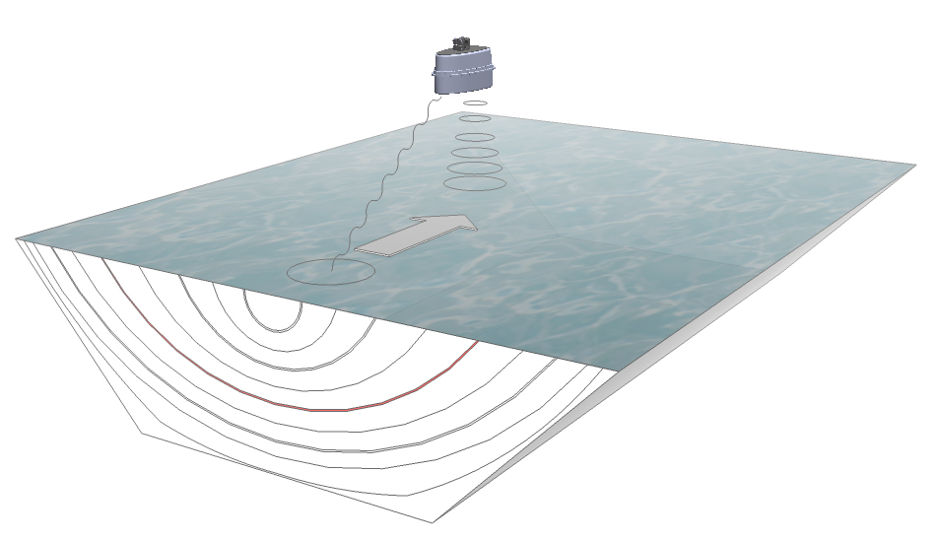


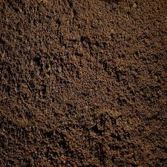
RQ-30 Discharge calculation
Measured from Sensor
water level measurement
Continuity Equation:
Q = v_{m} * A(W)
Defined (Q-Commander)
Calculated by sensor
V_{m} = V_{l} * k
local velocity v_{l} measurement
Discharge (Q)
mean velocity v_{m}
cross section
Area A (W)
k Factor
Water level
water area A(W)
Discharge Q
k-Factor
cross section profile
Local velocity v_{l}
Mean velocity
Notes:
The SQ measures the Level an the Velocity.
Then the sensor take the Cross section profile and calculate together with the water level the wetted area A(w).
After the SQ take the local velocity and the k-factors and calculate the mean velocity. The K-factors are coming form our hydraulic model and will be transfer to the SQ during the installation of the sensor.
The K-factors are related to the cross section profile shape, the water level and the roughness of the cross section profile .
After this 2 calculations the SQ will take the wetted area and the mean velocity and calculate the discharge in real-time.

Slide 20
Compare with Conventional Discharge Measurement
(Water level measurement with rating curve)
SOMMER - Hydrology

Slide 21
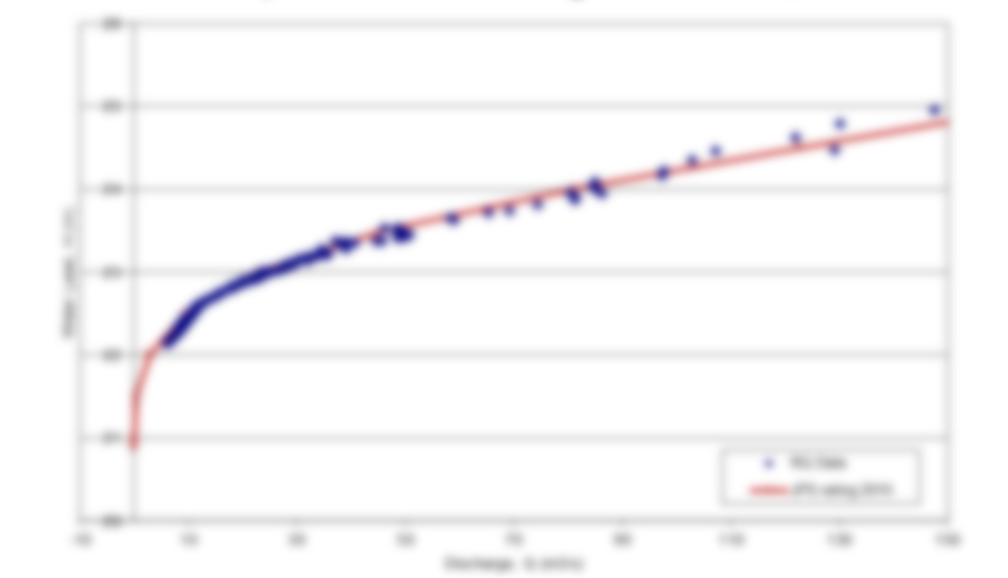
RQ-30 - Rating curve comparison
Water level sensor with Rating Curve
RQ-30 Method
Investment costs look lower (but operation cost are high)
Need Rating curve to calculate discharge
  Good rating curve need up to 2 years to create
  Very expensive equipment necessary to crate rating curve (current meter, ADCP boats)
  No accurate flood measurement (rating curve need to be calculated)
Only water level information to get to the discharge
  No information about velocity change
If riverbed change, NEW rating curve necessary !!
Flood waring only with water level
NO information about the real flow
Same infrastructure and same RTU station
Calculates discharge in the sensor
  Discharge right after the installation available
  NO reference measurements necessary
  (but possible)
  Reliable Measurement even during floods
Water level and velocity to calculate accurate discharge
  Detection of dynamic processes in the water
  Detection of riverbed change
  Hysteresis
  …
Input new cross section and DONE
Earlier waring of floods (velocity increase)
Detection of flow stop, blockage and backwater
Notes:
Conclusion:
The Rating curve looks easy and cheap, but to get a good discharge output from the rating curve, a lot of time, manpower and money is necessary.
With the RQ-30 the discharge is evidently available and also deliver more reliable discharge data because the real velocity is measured. The RQ-30 also deliver reliable and repeatable data during floods and high water condition.

Slide 22
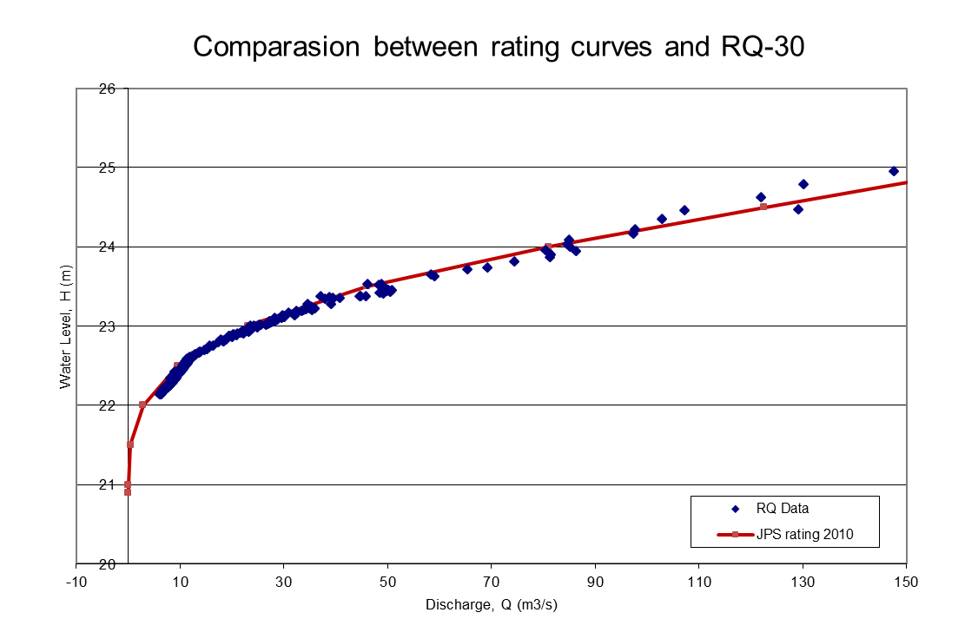
RQ-30 - Rating curve comparison
̶̶ ̶ Rating Curve, measurement time 2 years
From here Rating curve is calculated
River went over the banks
→ RQ-30, measurement time 1 month
Notes:
It took very long to generate the red rating curve and the top of the rating curve was extrapolated because in such high water conditions it was not possible to measure the discharge. In a very short time after the RQ installation the RQ proved the rating curve correct ant also monitored a floodwater situation.

Slide 23
RQ-30 Data set Analysis
(Application Examples)
SOMMER - Hydrology
Notes:
Now some Application examples.

Slide 24

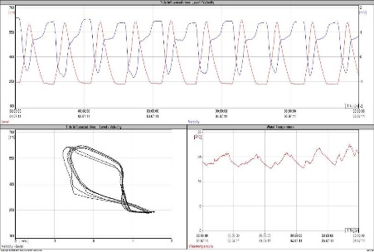
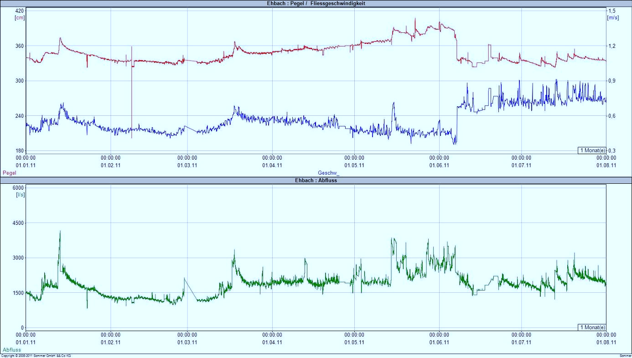
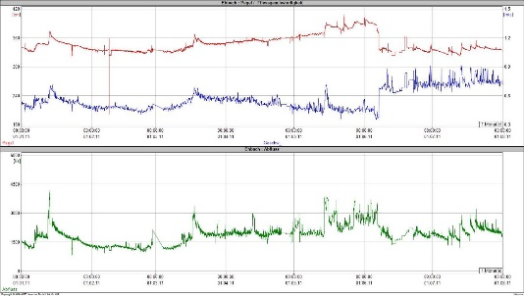
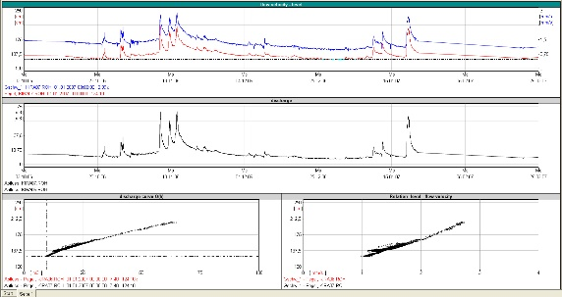
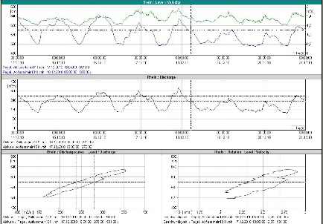
RQ-30 - Data set analysis
Recognition of dynamic processes in the water body
The RQ-30 deliver data to detect the following processes
in the water body and cross-section.
  Hysteresis
  Change of Riverbed
  Recognition of vegetation
  Change from normal flow to super- or subcritical flow
  Tide effects

Slide 25
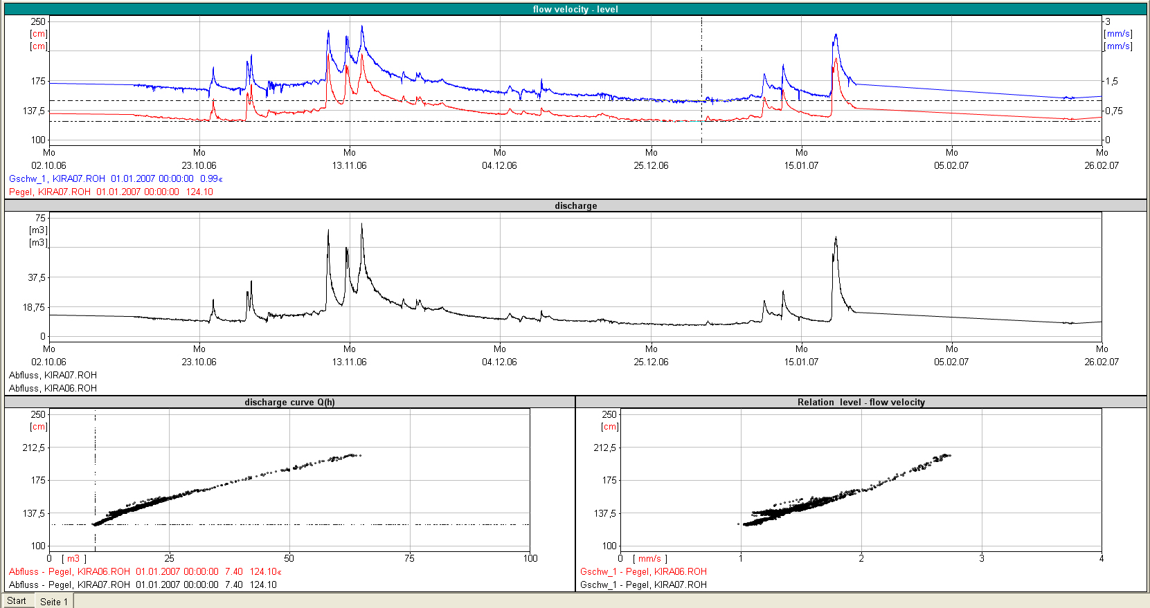
RQ-30 - Data set analysis
Continuous measurement of water level and flow velocity
  Control of quality of measurement and measuring site through generating the discharge curve
Blue = velocity / Red = Water level
Notes:
This is a perfect example. The Water level cure fits quite exactly together with the velocity curve and the discharge curve. NEXT page the curve is much bigger

Slide 26

RQ-30 - Data set analysis
You can see very fast increase an decrease of the water level and velocity.
Blue = velocity / Red = Water level
Notes:
You can see very fast increase of water level and velocity.

Slide 27
RQ-30 - Data set analysis
Rating curve created with the RQ-30
  Perfect rating curve of level and discharge. Very high repeatability.
Water Level [cm]
Discharge [m³/s]
  Rating curve of level and velocity with small “arms”. This are dynamic effects in the Water, like Hysteresis effect.
Water Level [cm]
Velocity [m/s]
Notes:
The Top is a perfect example of a rating curve in relation between level and discharge. The cure is very narrow and you see the repeatability of the measurement.
In the Bottom right corner is a rating curve in relation between level and velocity you see small arms going out of the curve. This are dynamic effect in the water, like hysteresis.

Slide 28
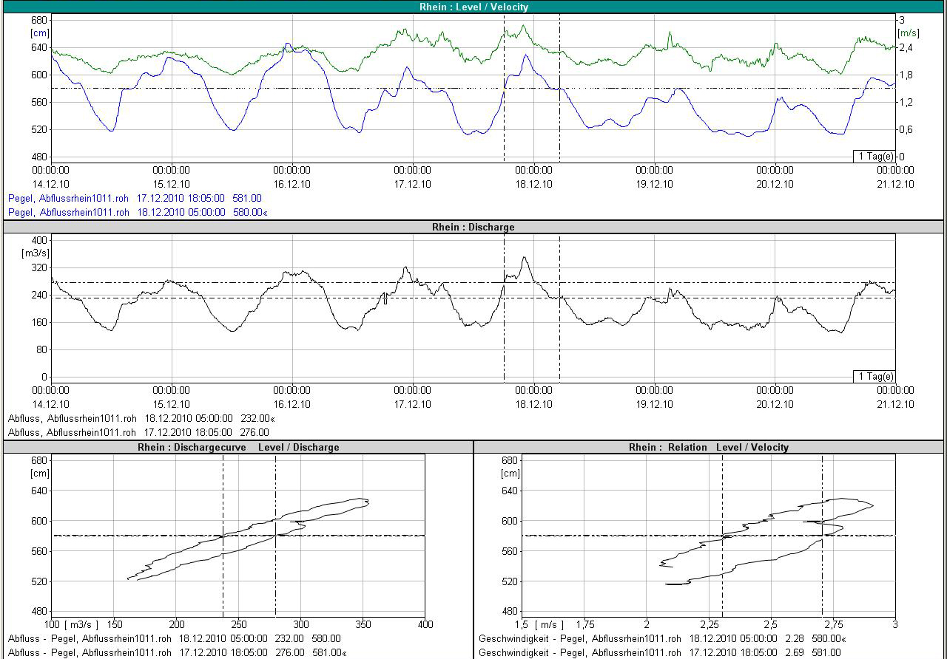
RQ-30 - Data set analysis
Recognition of flow hysteresis
Green = flow velocity / Blue = Water level
Notes:
What is the Hysteresis effect ? It is a hydraulic phenomenon. When the water level is increasing the flow velocity is faster when the water level is decreasing the flow velocity is slower. That means at the same Water level you can have 2 different velocity's. This you never find out if you only measure from time to time. But because the RQ-30 is stationary he will also monitor this kind of events.

Slide 29

RQ-30 - Data set analysis
At the same water level,
different velocity's
and a different discharge.
Water level is decreasing
Water level is increasing
Green = flow velocity
Blue = Water level
Notes:
What is the Hysteresis effect ? It is a hydraulic phenomenon. When the water level is increasing the flow velocity is faster when the water level is decreasing the flow velocity is slower. That means at the same Water level you can have 2 different velocity's. This you never find out if you only measure from time to time. But because the SQ is stationary he will also monitor this kind of events.

Slide 30
RQ-30 - Data set analysis
Rating curve of a river with hysteresis effect.
Water Level [cm]
Discharge [m³/s]
Notes:
The rating curve not looks like line any more. At rivers like this a stationary discharge measurement is needed to know the exact discharge over a long time period.
At rivers with hysteresis effect you can measure the discharge with the ACDP boat a 2 different time with the same level and you will get 2 different discharges.

Slide 31
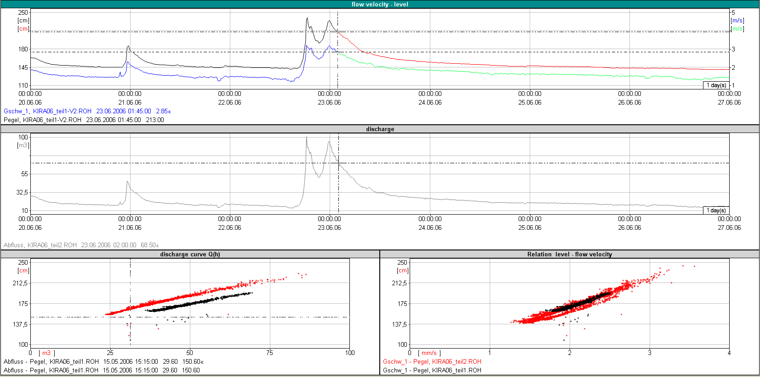
RQ-30 - Data set analysis
Recognition of river bed changes
Blue + Green = flow velocity / Black + Red = Water level

Slide 32

RQ-30 - Data set analysis
Recognition of cross section changes
Flood event
Before the flood event the black rating curve was measured.
After the flood event the rating curve has changed to the red one.
Blue + Green = velocity /
Black + Red = Water level
Water Level [cm]
Discharge [m³/s]
Notes:
After the flood the relation between Discharge and level has changed. This is a indication that the river bed has changed. If the river is only monitored with a level sensor you will not find out that the river bed has changed.

Slide 33
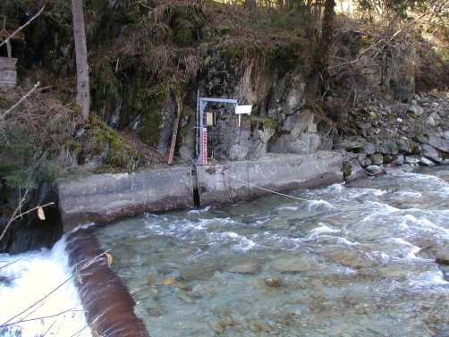



RQ-30 - Data set analysis
Recognition of flow characteristic from normal flow to
supercritical flow
  What is supercritical flow ? Supercritical flow is when the Velocity
  increases but the water level stay the same.
Notes:
What is supercritical flow ? Supercritical flow is when the Velocity increases but the water level stay the same. This happen most likely when the water drop over a ledge.

Slide 34

RQ-30 - Data set analysis
Velocity increases but the water level stay the same.
Velocity [m/s]
Water Level [cm]
Notes:
What is supercritical flow ? Supercritical flow is when the Velocity increases but the water level stay the same. This happen most likely when the water drop over a ledge.

Slide 35


RQ-30 - Data set analysis
River with very high vegetal invasion
  Removal of the vegetal invasion during the measurement time range.
Blue = flow velocity / Red = Water level / Green = Discharge

Slide 36
RQ-30 - Data set analysis
Water level and Velocity increase and decrease in the same rate
Vegetation starts growing and the water level increase but the velocity gets slower
The vegetation influent the velocity and water level correlation very much. Even though the discharge stayed over the hole period almost the same.
Vegetation was removed
Blue = flow velocity / Red = Water level / Green = Discharge

Slide 37



RQ-30 - Data set analysis
Tidal river in Belgium
  River width~ 50 m
  Reversal of the flow direction due to tide
  Tidal range ~ 4 m
  Installation on bridge railing
Blue = flow velocity / Red = Water level
Notes:
You can see very nice how the velocity getting positive and negative

Slide 38
RQ-30 - Data set analysis
Blue = flow velocity / Red = Water level
You even can see the influence of the moon
Water Level [cm]
Velocity [m/s]
Notes:
You can see very nice how the velocity getting positive and negative

Slide 39

Q – Commander software - Parameters

Slide 40






Q – Commander software - profiles
Diverse profile options
Egg shapes, circle, others
Trapezoid, rectangular

Slide 41

Q – Commander software - profiles

Slide 42




RQ-30 - Applications
Rivers, streams and mountain torrents
  Hydrographic services
  Civil service and protection
  Hydro power plants
Open channels, canals, drains
  Hydro power plants
  Waste water
  Industry
  Irrigation
  Water management

Slide 43



RQ-30 - Installation
Easy and economic installation
  No installation underwater
  No construction in the river necessary
  Installation all-the-year possible
  Mounting height from 0.5 to 75m
  Independent from flow direction
  Mobile and fixed installation
  Mounting at bridge without drilling
  Safe from vandalism

Slide 44
Multi sensor application RQ-30d
SOMMER - Hydrology

Slide 45

RQ-30d
For installation:
on wide rivers
above gates
on rivers with different flow characteristics across the surface
Multiple RQ-30d and/or RG-30d on one cross section
Divide the cross section in several vertical sections
Up to 8 devices on one bus
RG/RQ-30d slave
RQ-30d master
RG/RQ-30d slave

Slide 46
RQ-30d - Details
1x Master: RQ-30d
Max. 7x Slaves:
  RG-30d or RQ-30d
For extreme complex scenarios, flexibility is key
  RQ-30dL Master without Level
  RG-30d Slaves
  RL-15/35/75m Level sensors
Every partial discharge will be calculated
Total discharge sum will be outputted
Analog output of total discharge is possible
No averaging of velocity or level
No analog output of partial discharges

Slide 47

RQ-30d

Slide 48




RQ-30d
RQ-30d Slave 1 RQ-30d Master RQ-30d Slave 2
Notes:
The Cross section will be separated in parts and the discharge is calculated for each part separately and later added together in the Master unit.

Slide 49




RQ-30d – INN, schärding, Austria
River width about 240m
complex hydraulic situation:
  Bridge pillar, curve, inflow of an additional river
Measurement with 2 RQ-30d systems and calculation of the complete discharge
Installation on bridge railing
Power supply by solar panel and data transfer per radio

Slide 50
RQ-30d – INN, schärding, Austria
Notes:
River width about 240m
complex hydraulic situation:
Bridge pillar, curve, inflow of an additional river
Measurement with 2 RQ-30 systems and calculation of the complete discharge
Installation am bridge railing
Power supply by solar panel and data transfer per radio

Slide 51
RQ-30d – INN, schärding, Austria
River width about 240m
complex hydraulic situation:
  Bridge pillar, curve, inflow of an additional river
Measurement with 2 RQ-30d systems and calculation of the complete discharge
Installation on bridge railing
Power supply by solar panel and data transfer per radio

Slide 52
RQ-30d – INN, schärding, Austria
Comparison of the results
  Measurement 1 (2014)
  RP-30: 912,9 m³/s
  RQ-30d: 911,5 m³/s
  Measurement 2 (2016)
  ADCP-Boat: 684 m³/s
  RP-30: 671 m³/s
  RQ-30d: 680 m³/s
Difference between the measurement results:
  Measurement 1: + 0,15%
  Measurement 2: +0,6% and -1,3%

Slide 53



RQ-30d – Tainan, Taiwan
Notes:
River: Tainan, Taiwan
Low water ~20 m
High water ~600 m
Complex hydraulic Situation:
Curve upstream
Usually dry river bed
During tropical storms
Changes of the water level of 15 m in some hours
Measurement with 2 RQ-30 und 8 RG-30
Power supply with solar panel

Slide 54
SOMMER - Hydrology
Options

Slide 55



RQ-30 - options
RQ-30 – ADMS (Automatic discharge measurement station)
  All in one Solution
  RQ-30
  + data logger
  + modem for remote access and read out of data
  + battery for independent power supply
  all in one housing
  optional solar panel

Slide 56
RP-30 Radar Profiler
Hydrology
Mobile discharge measurement form low flow conditions up to flood situations

Slide 57

RP-30 Features
Measurement of surface velocity profile
Calculation of discharge
  With water level and cross section profile
Portable mobile measurement system
  Wireless data transmission via Bluetooth
  Easy user interface and handling
Application on cable ways, bridge railings and tripods
Contact free discharge measurement
  No danger from flotsam and debris
  Under flood conditions and for high flow velocities

Slide 58



Application possibilities
Carriage on handrail
On cable way
Tripod

Slide 59

Rhine - Bangs (Swiss)

Slide 60

RPCommander

Slide 61


Jll - Gisingen (Austria)

Slide 62

Jll - Gisingen (Austria)
Level: | 2.96 m | Discharge 1: | 139.1 m³/s
Area: | 52.3 m² | Discharge 2: | 141.7 m³/s
 |  |  | 140.4 m³/s

Slide 63


Applications

Slide 64
Data transmission and handling
SOMMER – Data handling

Slide 65



RQ-30 - options
Data logger with data transmission and remote access MRL 7
  2G/3G modem
  Data Logger with 80 Chanels/variables
  Solar charge regulator for internal and external battery's
  Backlit display for easy data readout
  Possible to attach a camera
  Logger can be operated fully independently (with batteries or solar-module), no switch cabinet required due to IP 67 rating

Slide 66

















SOMMER – Data handling
Cell tower:
(By cell operator)
MDS Server:
Receive data and stores data
Service and Maintenance:
Via Mobile internet remotely form the office or at home.
Internet
Internet
Internet
Measurement
Station:
Inmarsat satellite network
Satellite Ground station
www.mds.sommer.at :
Web platform to view and download measurement data.
Can be accessed from everywhere and several computers.
Mobile internet:
Data will be send via terrestrial 2G or 3G mobile internet network
Satellite modem:
Receive data from MRL-7 compress the data and send it to one of the INMARSAT satellites.
Online Data access
www.mds.sommer.at
MRL-7 Data logger:
Logs the measurement data
Send data Measurement data via internal mobile internet modem or optional Satellite modem to the customer
Control the charging of the Battery
Internet
Sensors:
Discharge
Level
Precipitation
Turbidity
temperature
Data analysis:
Metwin.net:
To analyse measurement data. Metwin.net will get data direly automatically from MDS Server.
Local computer in the
customer office
Solar Panel
Time laps camera
Battery:
In the switch cabinet.
Will be charged by the Solar
panel and the solar regulator
in the MRL-7
Switch cabinet

Slide 67



SOMMER – Data handling - logger
Benefits of remote access to MRL 7
  Full remote access to SOMMER sensors
    Up to 8 SOMMER sensors with one controller
  Remote Parametrization
  Remote data read out
  Remote side analysis and adjustment
  Connection via SOMMER commander software
Internet

Slide 68



RQ-30 - options
MDS Server (Measured data server)
  SOMMER data hosting service
  easy access to actual data
  Graphical visualisation
  Easy download of data in .csv format

Slide 69


data processing
>> Download your Demo Metwin version from your MDS account:
mds.sommer.at
Username: demo
Password: sommer

Slide 70

data processing

Slide 71
RQ-30 - summary
Ccontact free radar measurement → safe and maintenance free
Accurate measurement also in flood condition
Continuous measurement
No fouling
Rating curve Q(h) not required
Recognition of changes in river bed
No limitation with regards to minimum water depth
Fast and easy installation

Slide 72
Application Pictures
SOMMER - Hydrology

Slide 73



RQ-30 - Applications
Tirol, Austria
Enshi, China
China

Slide 74



RQ-30 - Applications
USA
Australia
Zimbabwe

Slide 75




RQ-30 - Applications
Different installations

Slide 76



RQ-30 - Applications
RQ-30 ADMS, Vorarlberg, Austria
Tirol, Austria
Malaysia

Slide 77



RQ-30 - Applications
Papa New Guinee

Slide 78



RQ-30 - Applications
Adana, Turkey
Schwanden, Swiss
Brenner, Italy

Slide 79

RQ-30d – Tibet, china
Slave
Master
Slave

Slide 80




RQ-30 - Applications
China, Tibet
https://nature.desktopnexus.com/wallpaper/351348/

Slide 81





TQ – tracer SENSOR
Mobile discharge measurement system
  Wireless data transmission via Bluetooth
  Easy user interface and handling
Calculation of discharge without knowing the cross-section
Tracer can be used where no other method is feasible
Optimal for high velocities and turbulent rivers – but also in “normal” rivers
Based on tracer dilution method
  Different tracers available
  No harm to the environment

Slide 82





TQ – TRACER measurement principle
River
Laptop
TQ- Amplifier
Bluetooth
connection
River water for
calibration

Slide 83

TQ – measurement principle
River
Laptop
TQ- Amplifier
Bluetooth
connection
TQ- Probes
Calibration bucket

Slide 84






TQ – measurement principle
1) Injection of a known quantity of tracer solution
River
2) Tracer flows down the river and is well mixed with the water
3) Homogenous distribution of tracer at the measurement site. Recording the change of conductivity or fluorescence.
Laptop
TQ- Probes
TQ- Amplifier
Bluetooth
connection
4) Real-time visualization of the measurement and determination of discharge

Slide 85

Measurement – Example TQ-S
5 kg NaCl

Slide 86





TQ – summary
Mobile discharge measurement in rivers with
unknown cross section
Based on dilution method
Discharge quantity immediately available
Data transmission via Bluetooth with mobile PC
Real-time visualization of results
Simultaneous measurement with up to 4 sensors for increased accuracy and validation of measurement
Optimal for turbulent rivers

Slide 87




TQ – applications

Slide 88




Fish bypasses

Slide 89



RQ-30
Thank you for your attention!
Further Questions?
Rhine, Vorarlberg
Loisach, Bavaria
Inn, Upper Austria

